Slide 1
Reclaiming conversation
The power of talk in a digital age
Book by Sherry Turkle
Presentation by Catherine DeJager

Slide 2
Raise your hand if this applies to you
Generally speaking, you would rather have a conversation virtually than in-person. (Assume this is outside of the context of a pandemic or other situation that prevents many in-person interactions.)

Slide 3
Raise your hand if this applies to you
Your first impulse in a moment of free time is to pull out your phone or other technological device.

Slide 4
Raise your hand if this applies to you
Sitting in silence with your thoughts for a few minutes would make you uncomfortable.

Slide 5
Raise your hand if this applies to you
You have had an in-person conversation disrupted because someone is on their phone or other technology.

Slide 6
Raise your hand if this applies to you
You have used technology during an in-person conversation for something unrelated to the conversation.

Slide 7
Raise your hand if this applies to you
You have asked someone else for help in wording a text/chat message or email.

Slide 8
Raise your hand if this applies to you
You have chosen to do a difficult conversation (e.g., argument, apology, breakup) via technology when in-person was an option or text-based communication when in-person was not an option and calling was.

Slide 9
Raise your hand if this applies to you
You consider yourself a multitasker.

Slide 10
Raise your hand if this applies to you
During a virtual meeting, class, or conversation you have used that a device to do something unrelated (e.g., browse the web, play games, use social media).

Slide 11
Raise your hand if this applies to you
You have said “thank you” to what you knew was an AI.

Slide 12
Close your eyes for this next question

Slide 13
Raise your hand if this applies to you
You would have answered any of the previous questions differently if this was an anonymous virtual survey.

Slide 14
Introduction

Slide 15
Introduction
When most of our conversations are virtual, our empathy is underdeveloped
Generally speaking, we would rather have a conversation virtually than in-person.
We tend to escape from the boring or uncomfortable parts of in-person conversations by using technology during the conversation

Slide 16
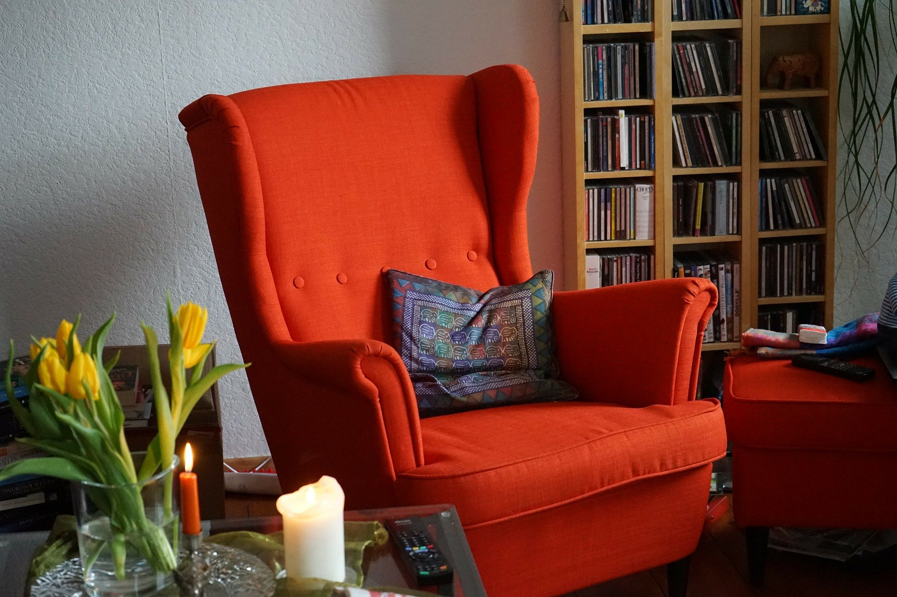
One chair

Slide 17
One chair
Technology is easily available so it can keep us from taking time for solitude (alone time with our thoughts).
Many of us are uncomfortable to sit alone with our thoughts and will use technology to avoid that.
When we allow solitude, we have time for self-reflection. Our self-reflection can also be influenced by algorithms (e.g., Facebook Newsfeed, fitness trackers)

Slide 18

Two chairs

Slide 19
Two chairs
Virtual communication can disrupt relationships because you aren’t present for in-person conversation.
Virtual communication can be a way to avoid the emotions of difficult conversations (e.g., arguments, apologies).
Virtual communication allows you to present your best self, which may make a relationship feel smooth at first but can lead to false promises and disappointment.

Slide 20
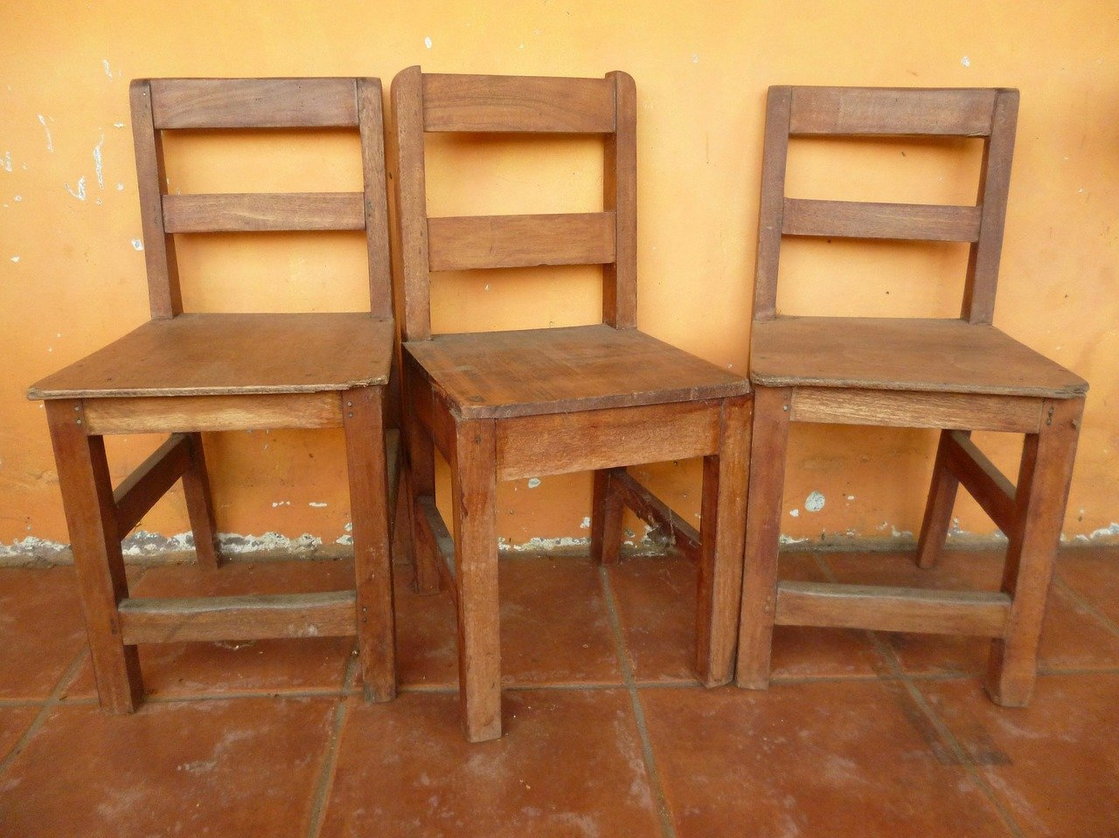
Three chairs

Slide 21
Three chairs
Multitasking is a myth and distracts you and everyone around you
In a study of work environments, “Face to face conversation leads to higher productivity and is also associated with reduced stress”

Slide 22
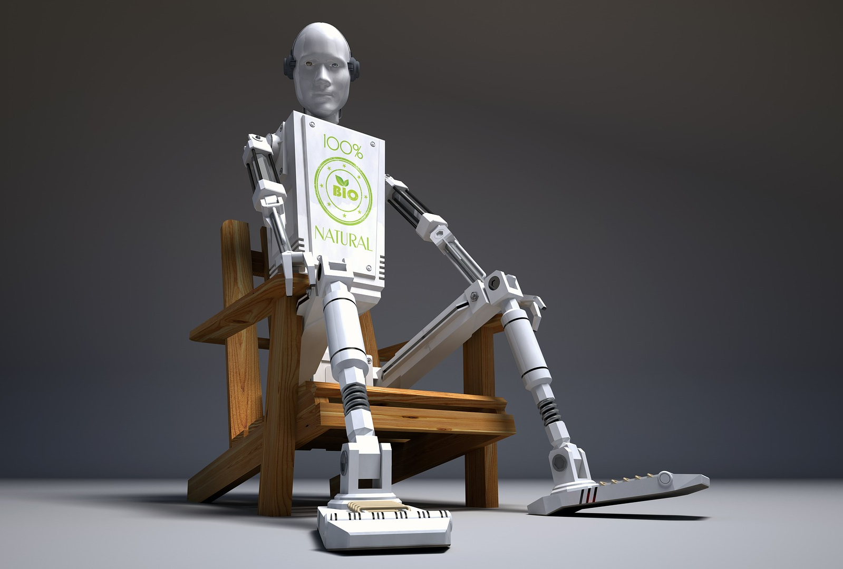
A fourth chair?

Slide 23
A fourth chair?
We may converse with AI as if it is human, but AI doesn’t have empathy, it can only simulate empathy
AI companionship can be a way for humans to get out of companionship work they should be doing (e.g., carers for old people)

Slide 24
suggestions

Slide 25
Suggestions
Remember the power of your phone
Take your time and take quiet time
Create sacred spaces for conversation
Unitask
Talk to people with whom you disagree
Be patient with conversation (e.g., give it at least 7 minutes before going to your phone)
Challenge a view of the world as apps
Choose the right tool for the job
Learn from moments of friction
Remember what you know about life
Don’t avoid difficult conversations
Try to avoid all or nothing thinking

Slide 26
Personal response

Slide 27
Personal response
I think Turkle does a good job of presenting a variety of issues caused by virtual conversation and providing suggestions for how to deal with these issues.

Slide 28
Design norms

Slide 29
Design norms
Cultural appropriateness
Lingual and communication norm
Social norm
Economic norm

Slide 30
Questions?

Slide 31
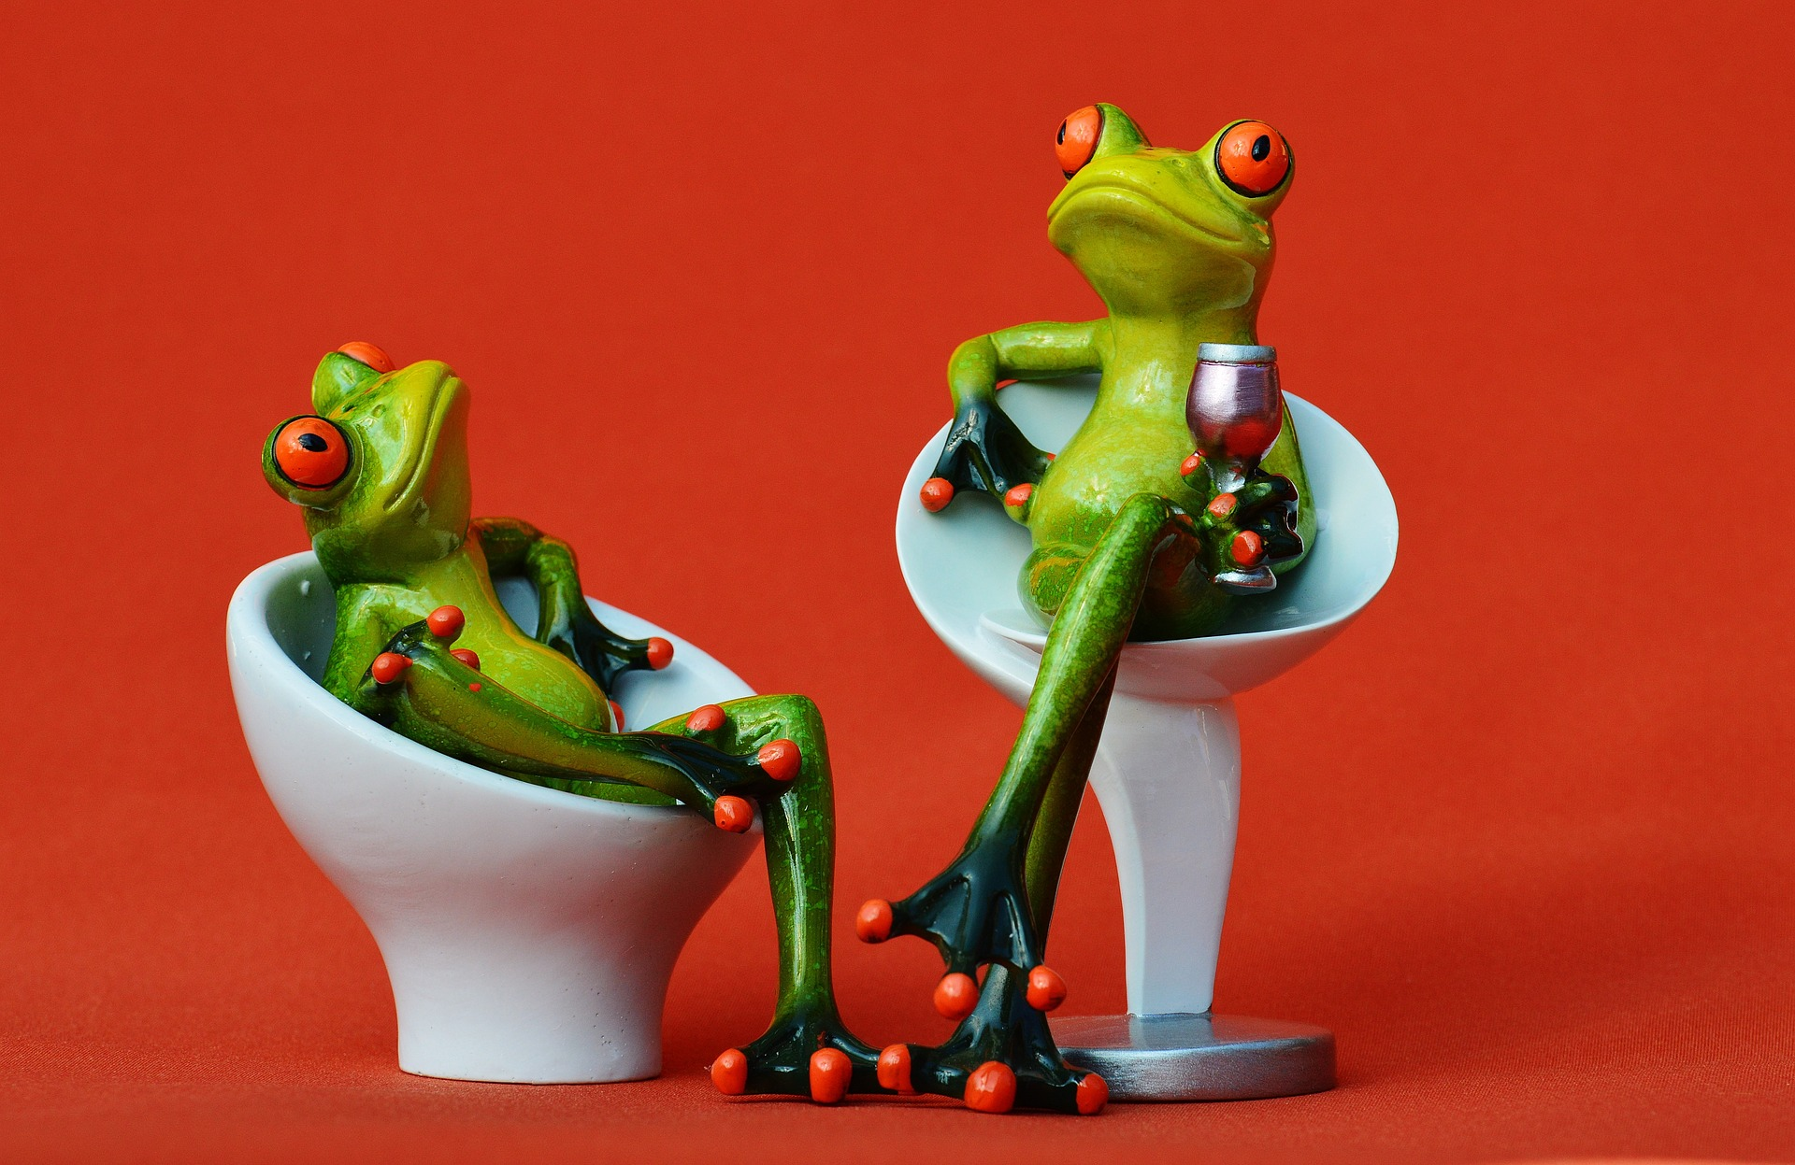
Bonus image

Slide 32
Credits for images
All images collected from Pixabay (no attribution required)

